Slide 1
Activity 1
Watch the presentation and write
down the first thing that comes to your
mind inside each box on your worksheet

Slide 2
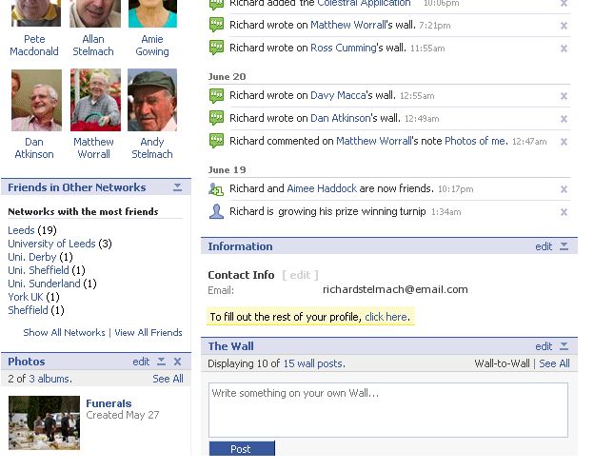
1

Slide 3
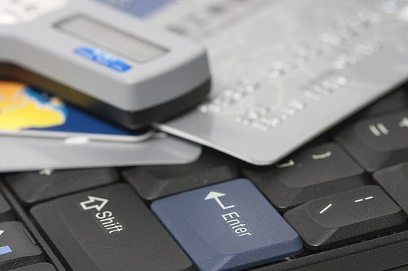
2

Slide 4

3

Slide 5
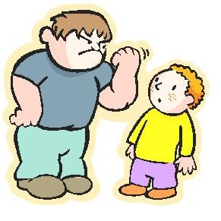
4

Slide 6

5

Slide 7


6

Slide 8
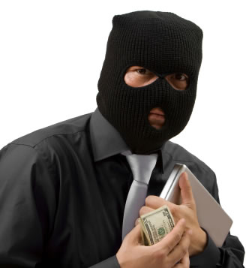
7

Slide 9

8

Slide 10
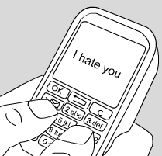
9

Slide 11

10

Slide 12
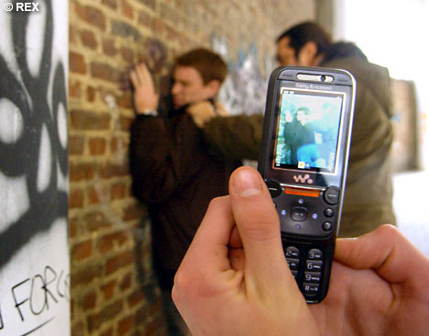
11

Slide 13
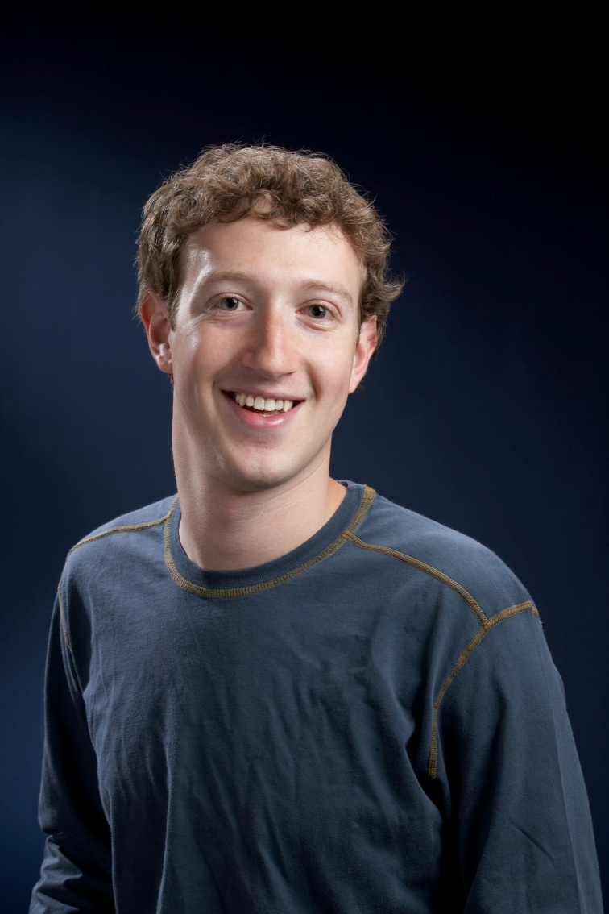
12

Slide 14
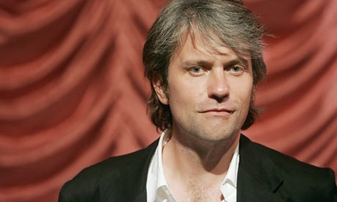

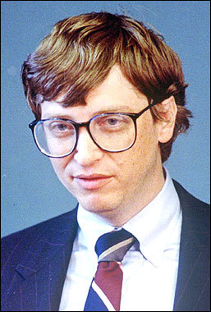

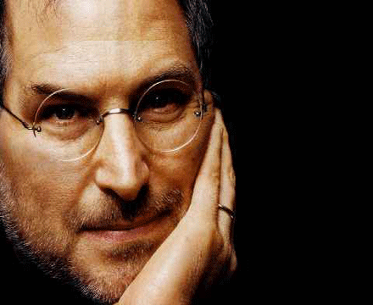
13

Slide 15

The Internet is Amazing

Slide 16

Talk to your parents
Don't download any software without permission
Never give out your password
Respect people's privacy
Using the internet safely
Don't give out your contact details
Use a child safe web browser
Respect copyright
Use the internet safely and responsibly

Slide 17
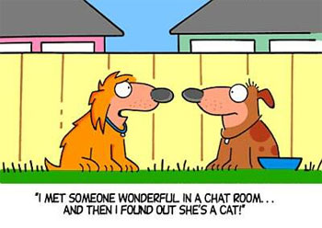
The problems with chat rooms

Slide 18
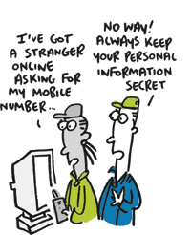
Talk to your parents
Staying safe in chatrooms
Don't meet up in real life on your own
Use a Nick Name
Don't give out your contact details
Stay in the public chatroom
Don’t send your photo to anyone
Don’t open attachments from people you don’t know

Slide 19
Cyber bullying ☹

Slide 20

Dealing with Cyber bullying
Don't give out your contact details
Contact the website
Don’t send your photo to anyone
Tell someone – don’t suffer in silent
Don’t respond back

Slide 21
Who is Mark Zuckerburg?
1. Creator of Facebook
2. Friday 14th May / 26 Years old
3. Billionaire
4. 400 million people+ using it
5. Facebook is only 6 years old
Question! Imagine all the status-updates that you ever done on Facebook, suddenly became public via a search engine like Google.
How would you feel?

Slide 22
MySPACE
Chris DeWolfe
GOOGLE
Larry Page and Sergi Brin
Microsoft
Does this man need any introduction?
APPLE
Steve Jobs
Humble Beginnings for all these entrepreneurs

